Slide 1
Web Design and Programming Lab-I
Outcome Based Education System
Dr. Abu Sayed Md. Mostafizur Rahaman
Professor
Anup Majumder
Assistant Professor
Bulbul Ahammad
Assistant Professor
Subarna Saha
Class Roll: 349
Exam Roll: 202165
Trisha Sarkar
Class Roll: 359
Exam Roll: 202171
Rubayed All Islam
Class Roll: 370
Exam Roll: 202182
Department of Computer Science and Engineering
Jahangirnagar University, Savar,
Dhaka-1342, Bangladesh

Slide 2
Contents
Features of OBE System
Login Registration System
Teacher Dashboard
Department Admin Dashboard
Exam Control Office Dashboard

Slide 3
Features of the Web Application
Login and Registration System
Teacher Dashboard
View Academic Calendar
Show the List of Assigned Courses
Manage Course Files
Manage Marks Submission
Department Admin Dashboard
Upload Academic Calendar
Approve Teacher Account
Assign Course Teacher
Create Exam
Same functionalities of Teacher
Exam Control Office Dashboard
Provides a User Interface for Submit Marks

Slide 4
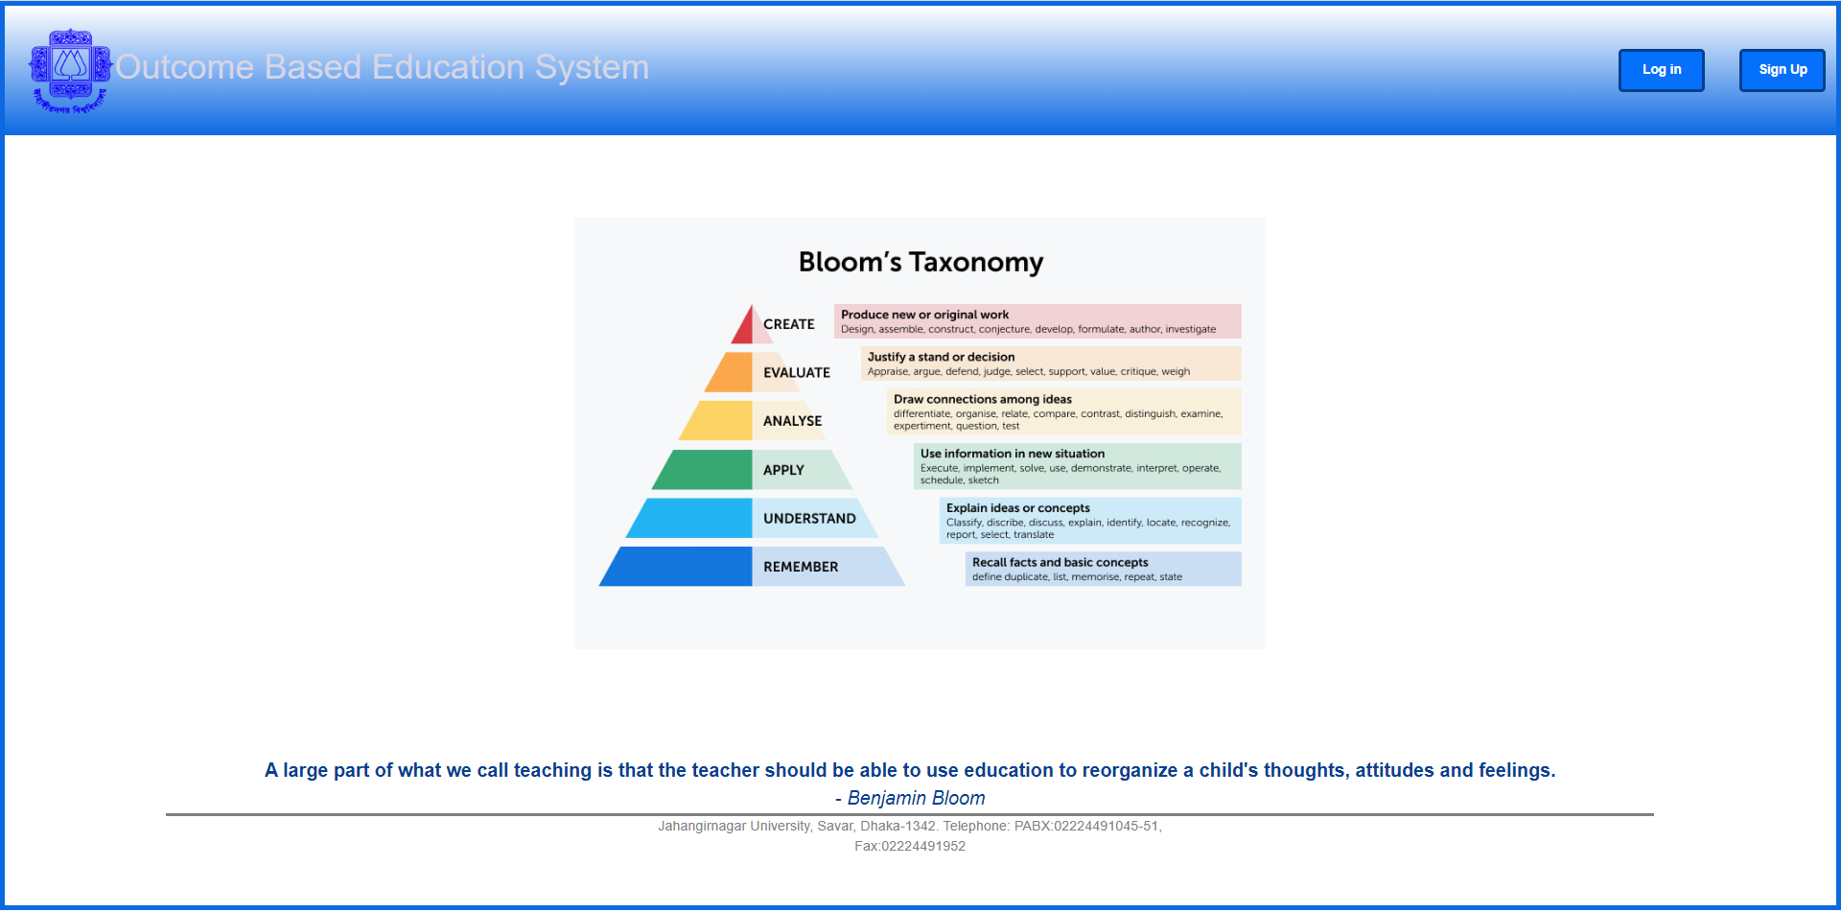
Home Page

Slide 5
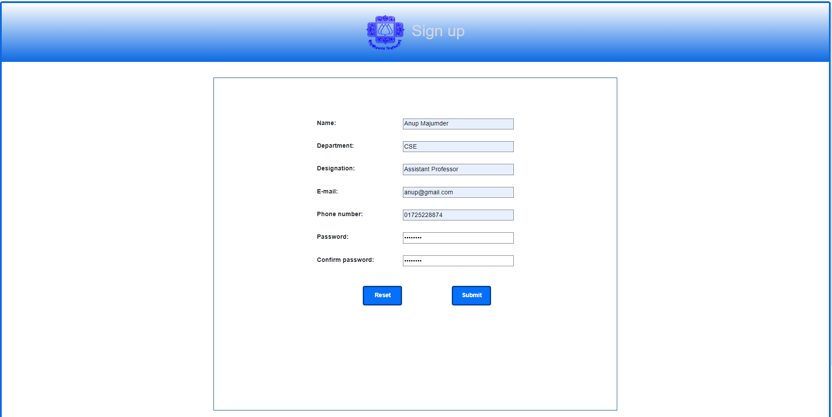
Registration

Slide 6
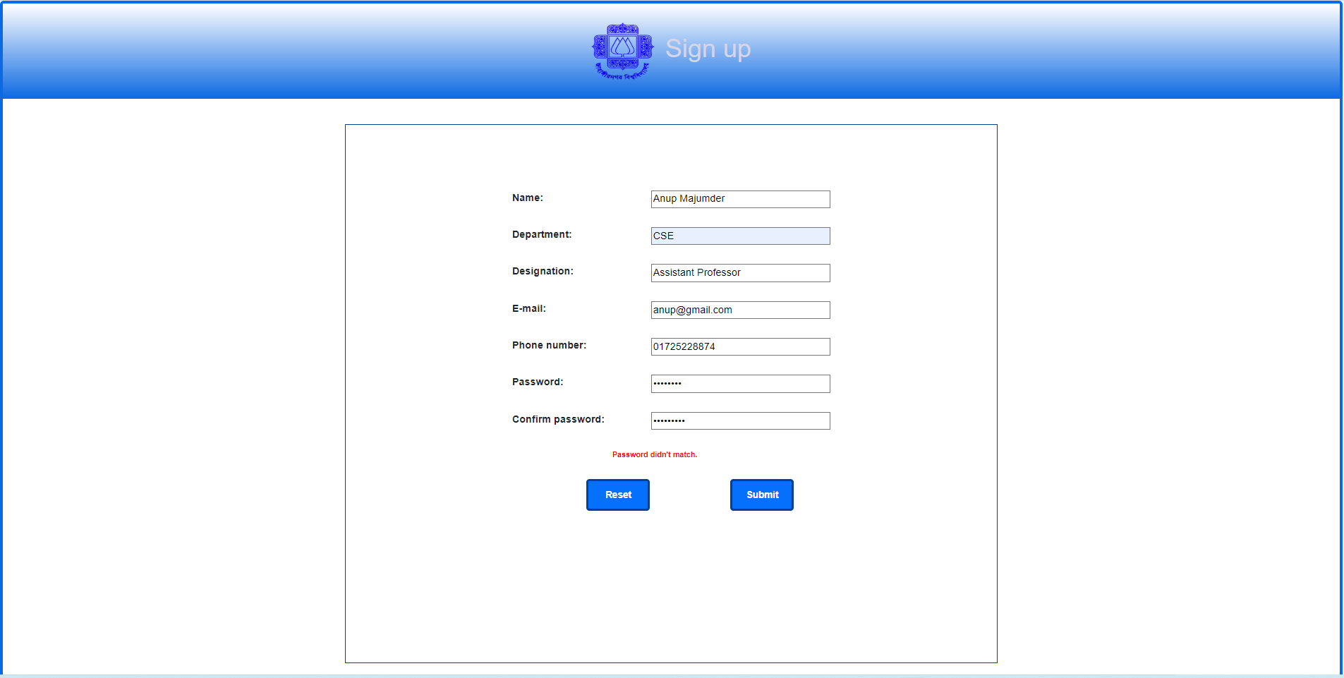
Case of Mismatch Password

Slide 7
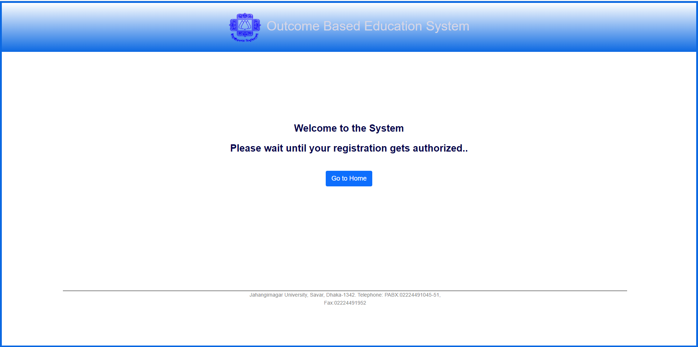
Welcome Page

Slide 8
Teacher Part

Slide 9
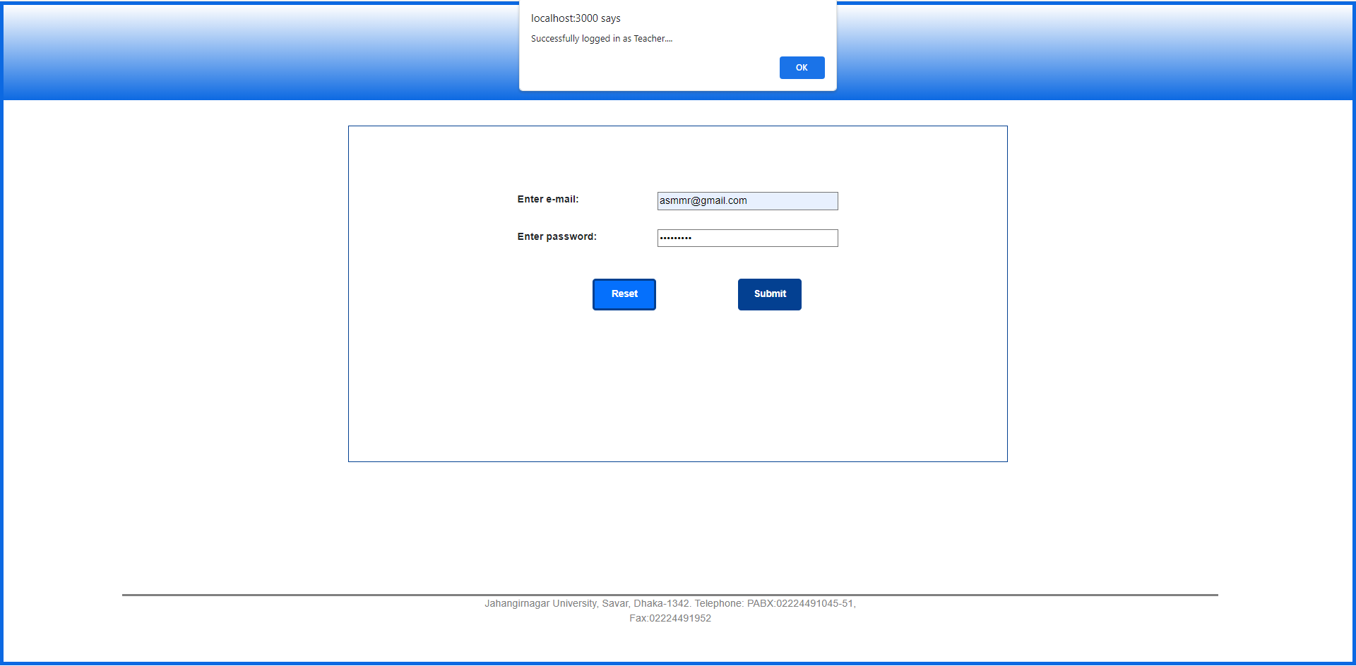
Log In page

Slide 10
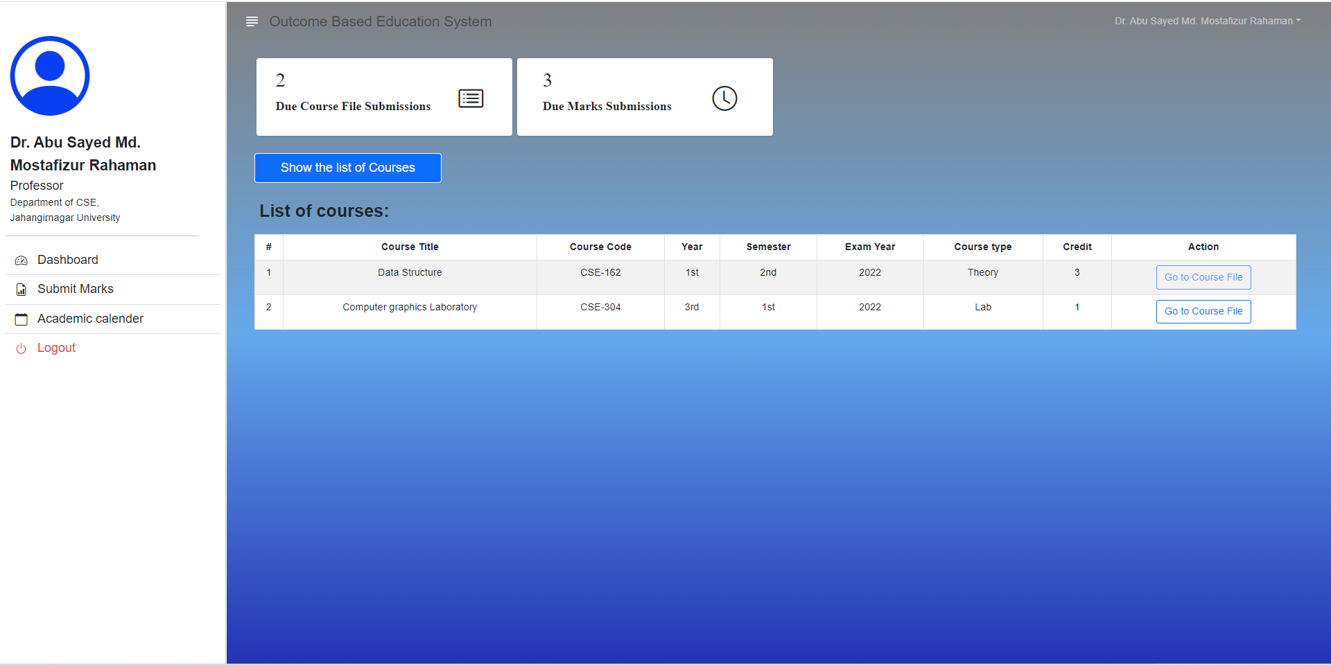
Teacher Dashboard

Slide 11
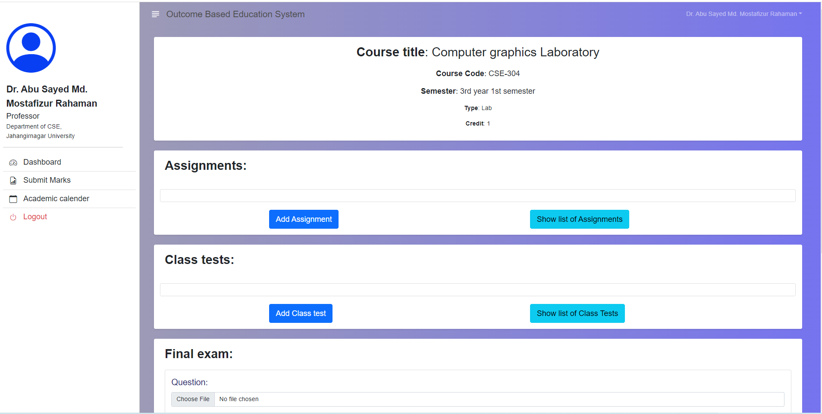
Manage Course File

Slide 12
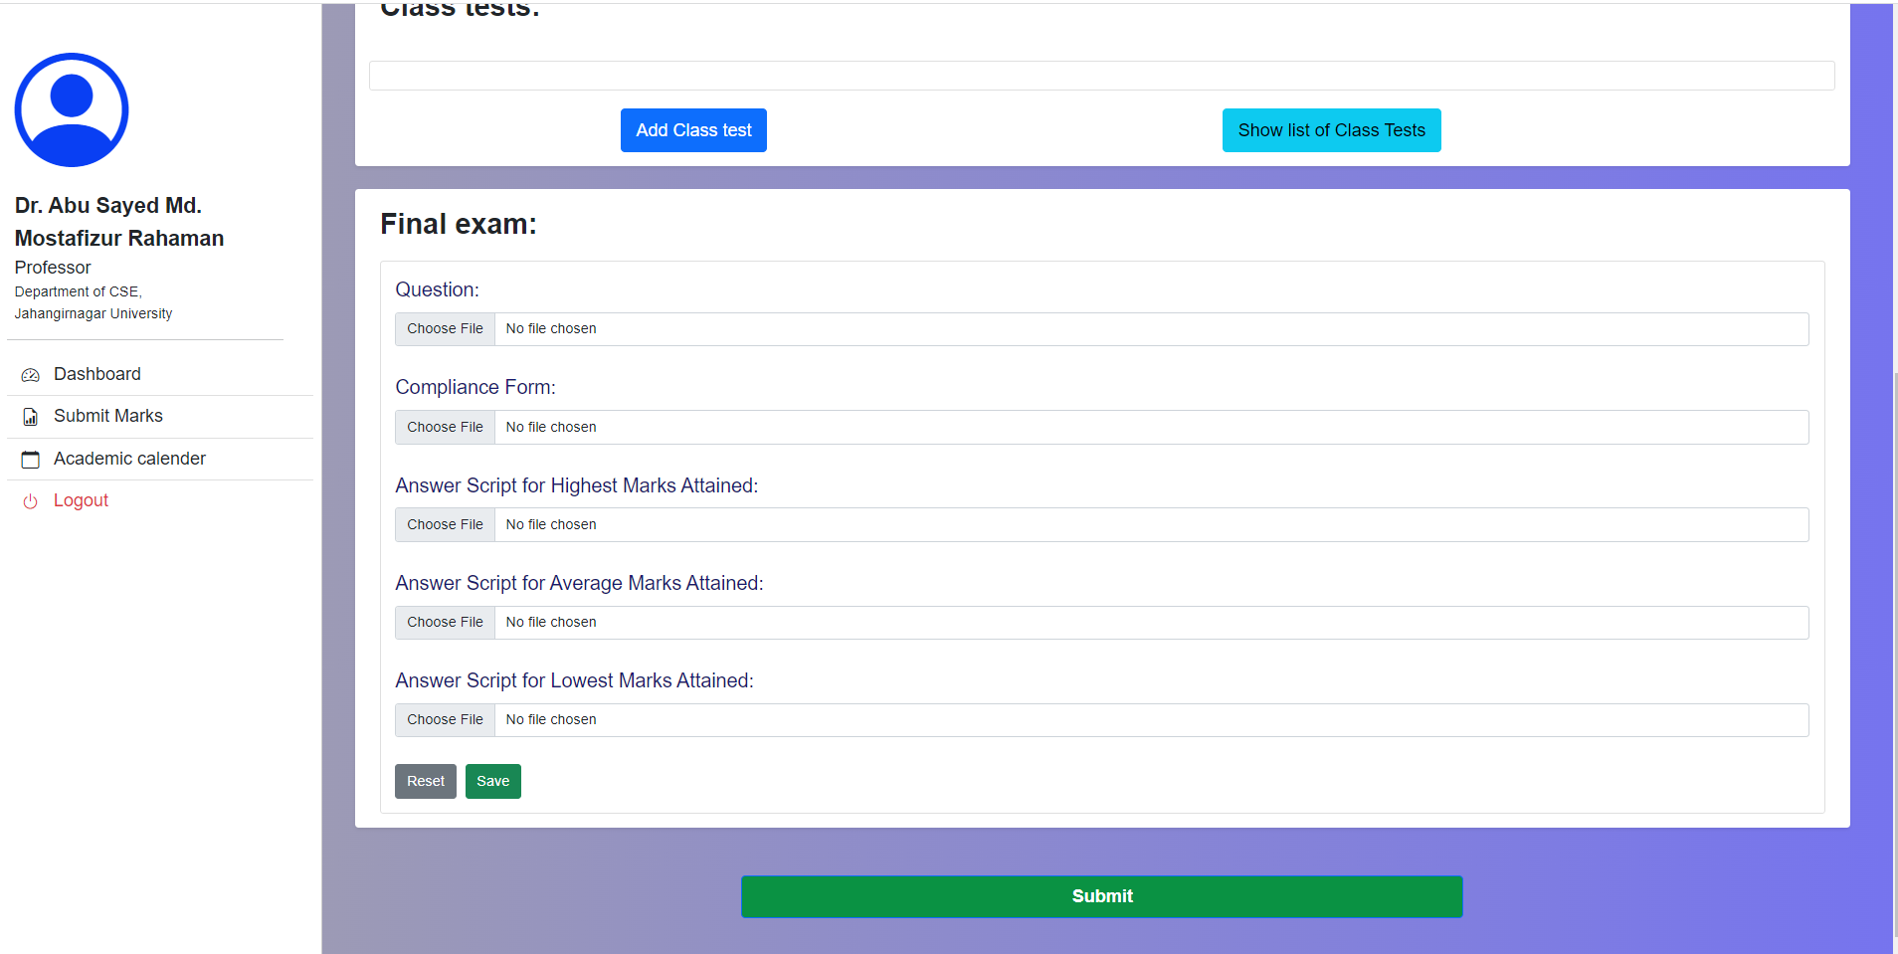
Manage Course File Cont….

Slide 13
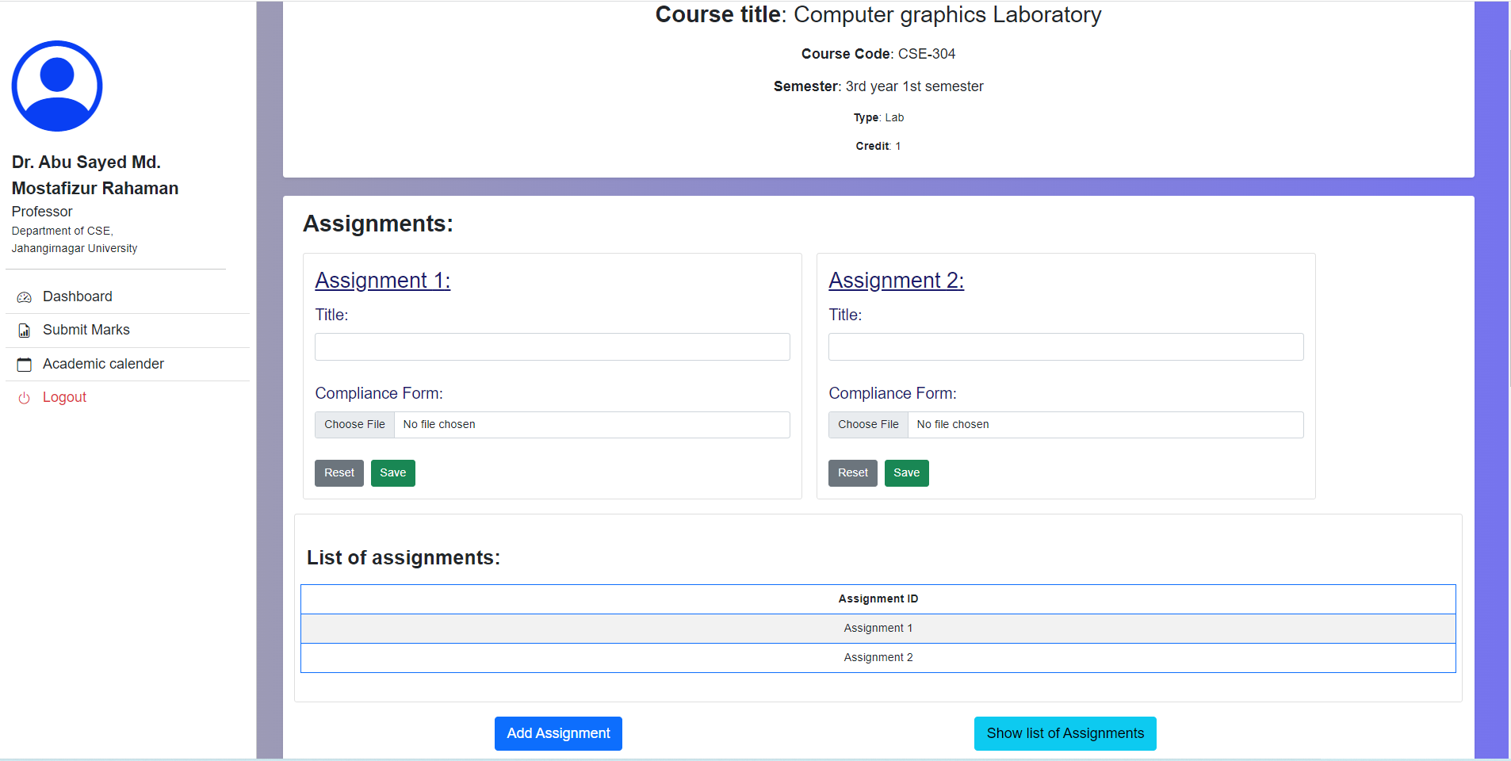
Manage Course File Cont…..

Slide 14
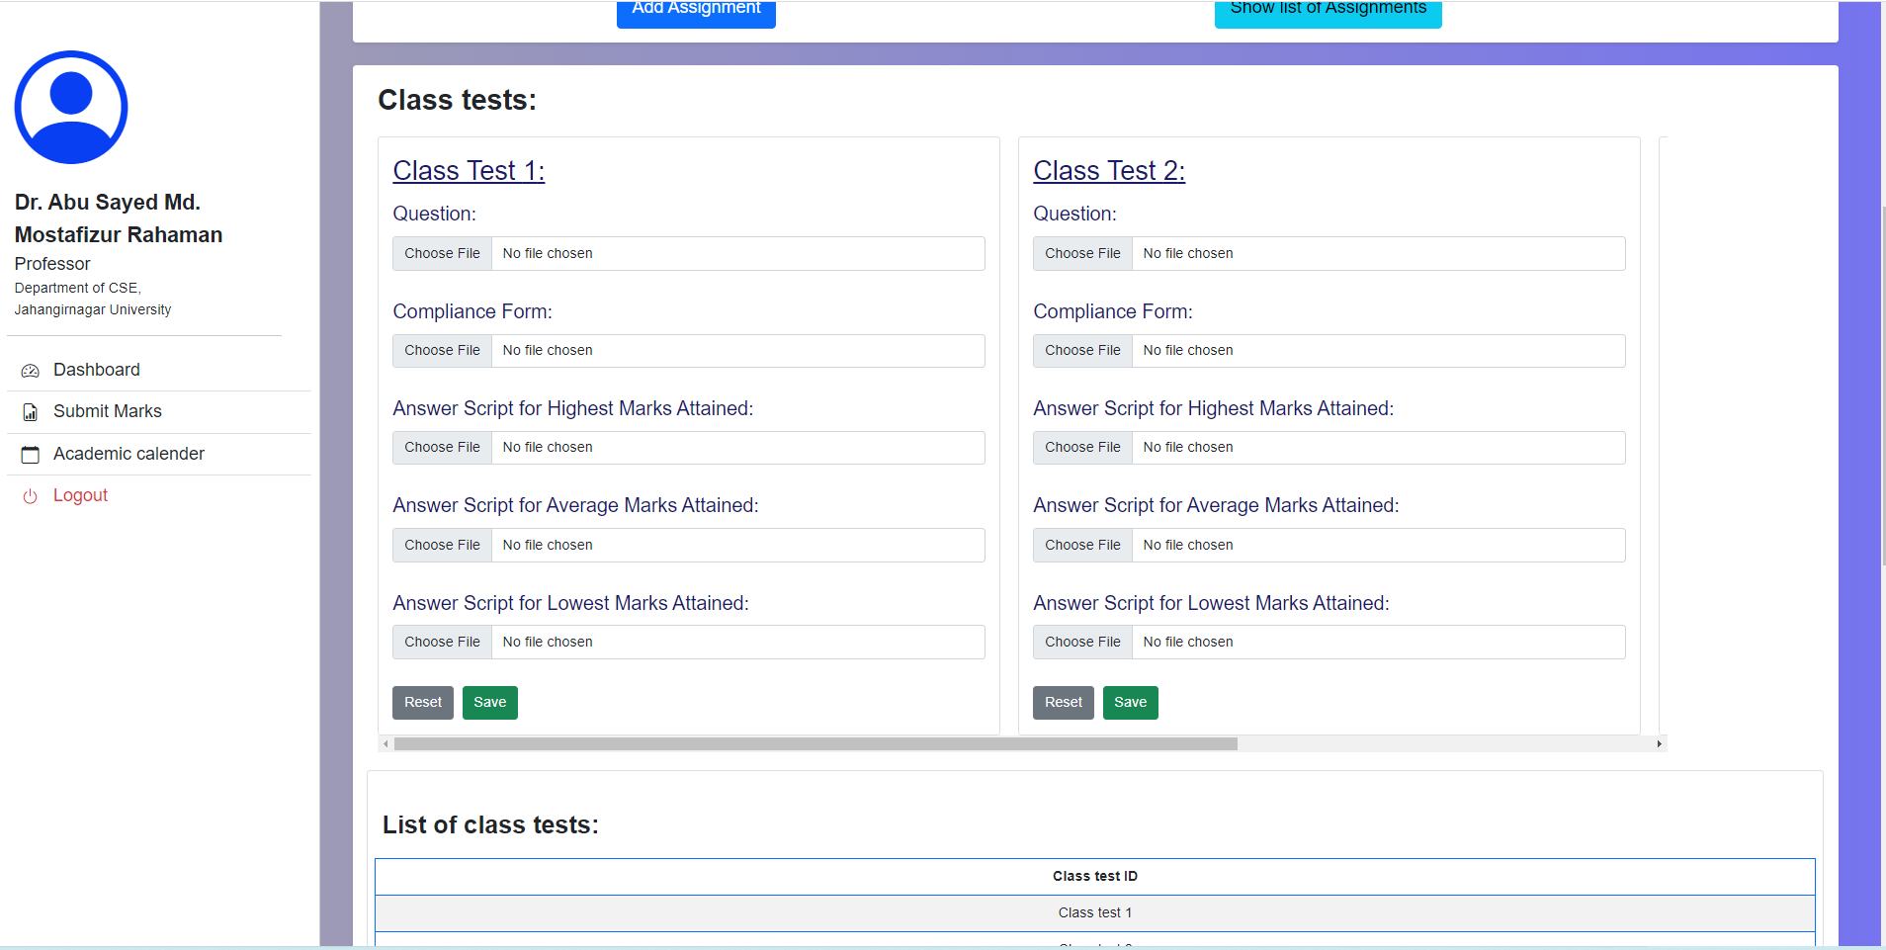
Manage Course File Cont…..

Slide 15
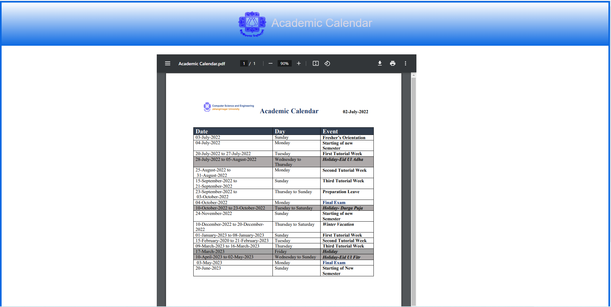
Academic Calendar

Slide 16
Department Admin Part

Slide 17
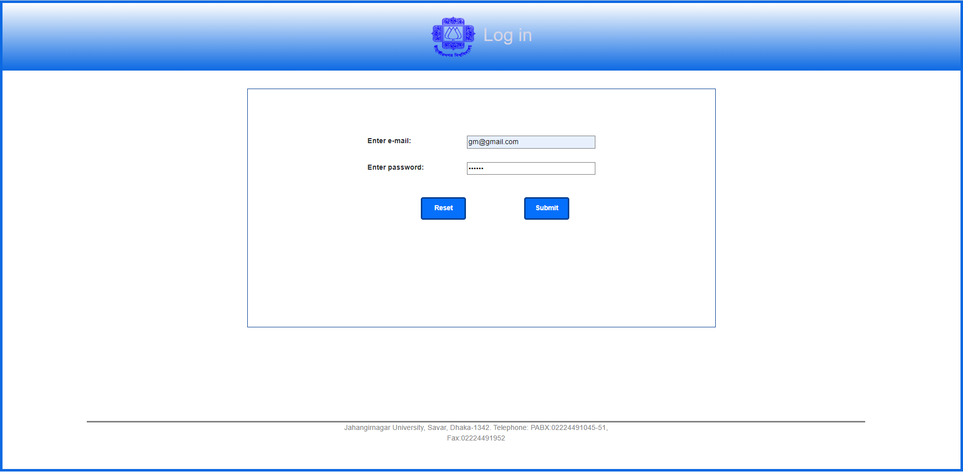
Log In As Department Admin

Slide 18
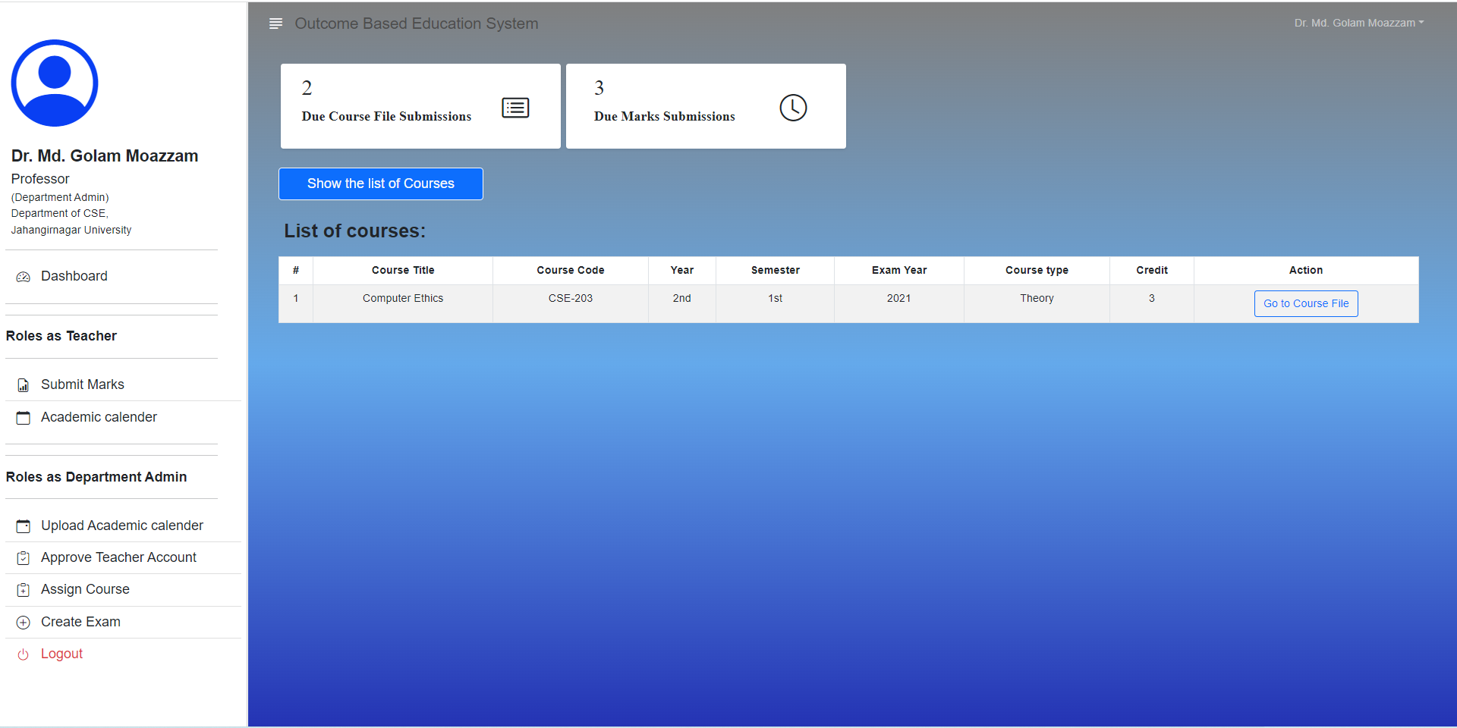
Department Admin Dashboard

Slide 19
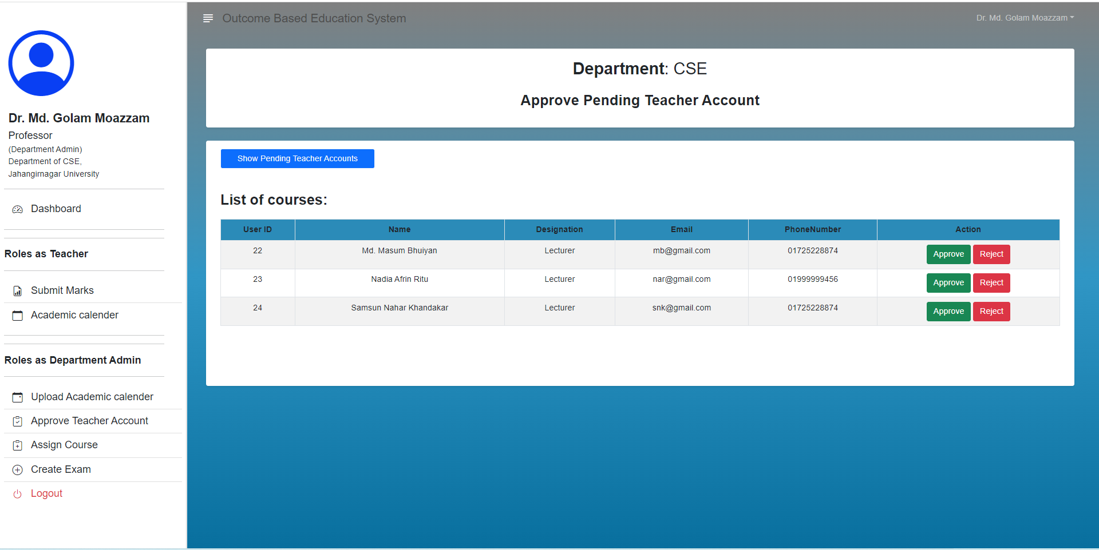
Approve Pending Teacher Accounts

Slide 20
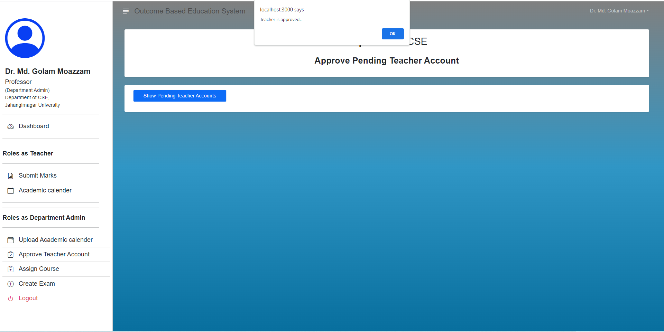
Approve Pending Teacher Accounts

Slide 21
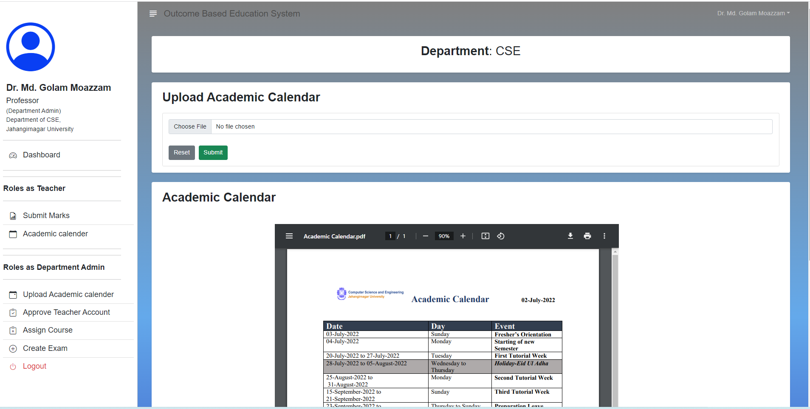
Upload Academic Calendar

Slide 22
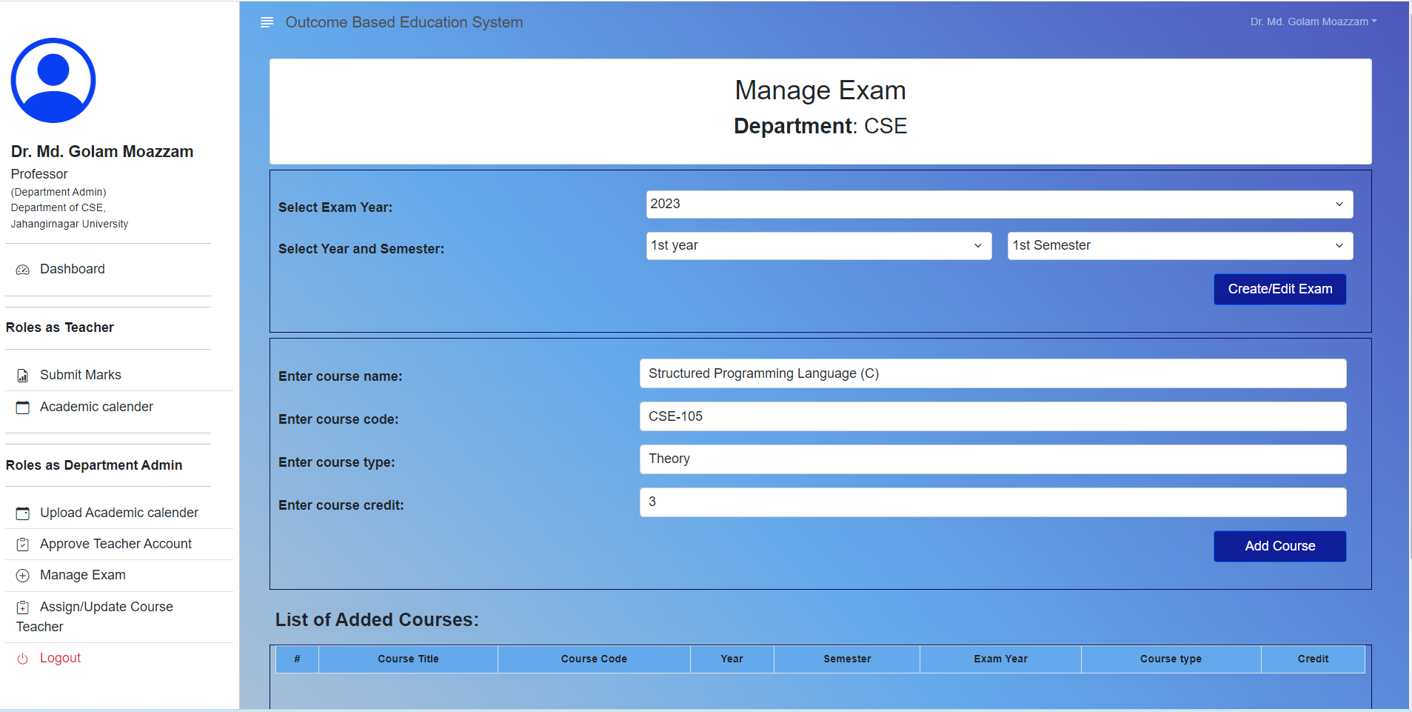
Manage Exam

Slide 23
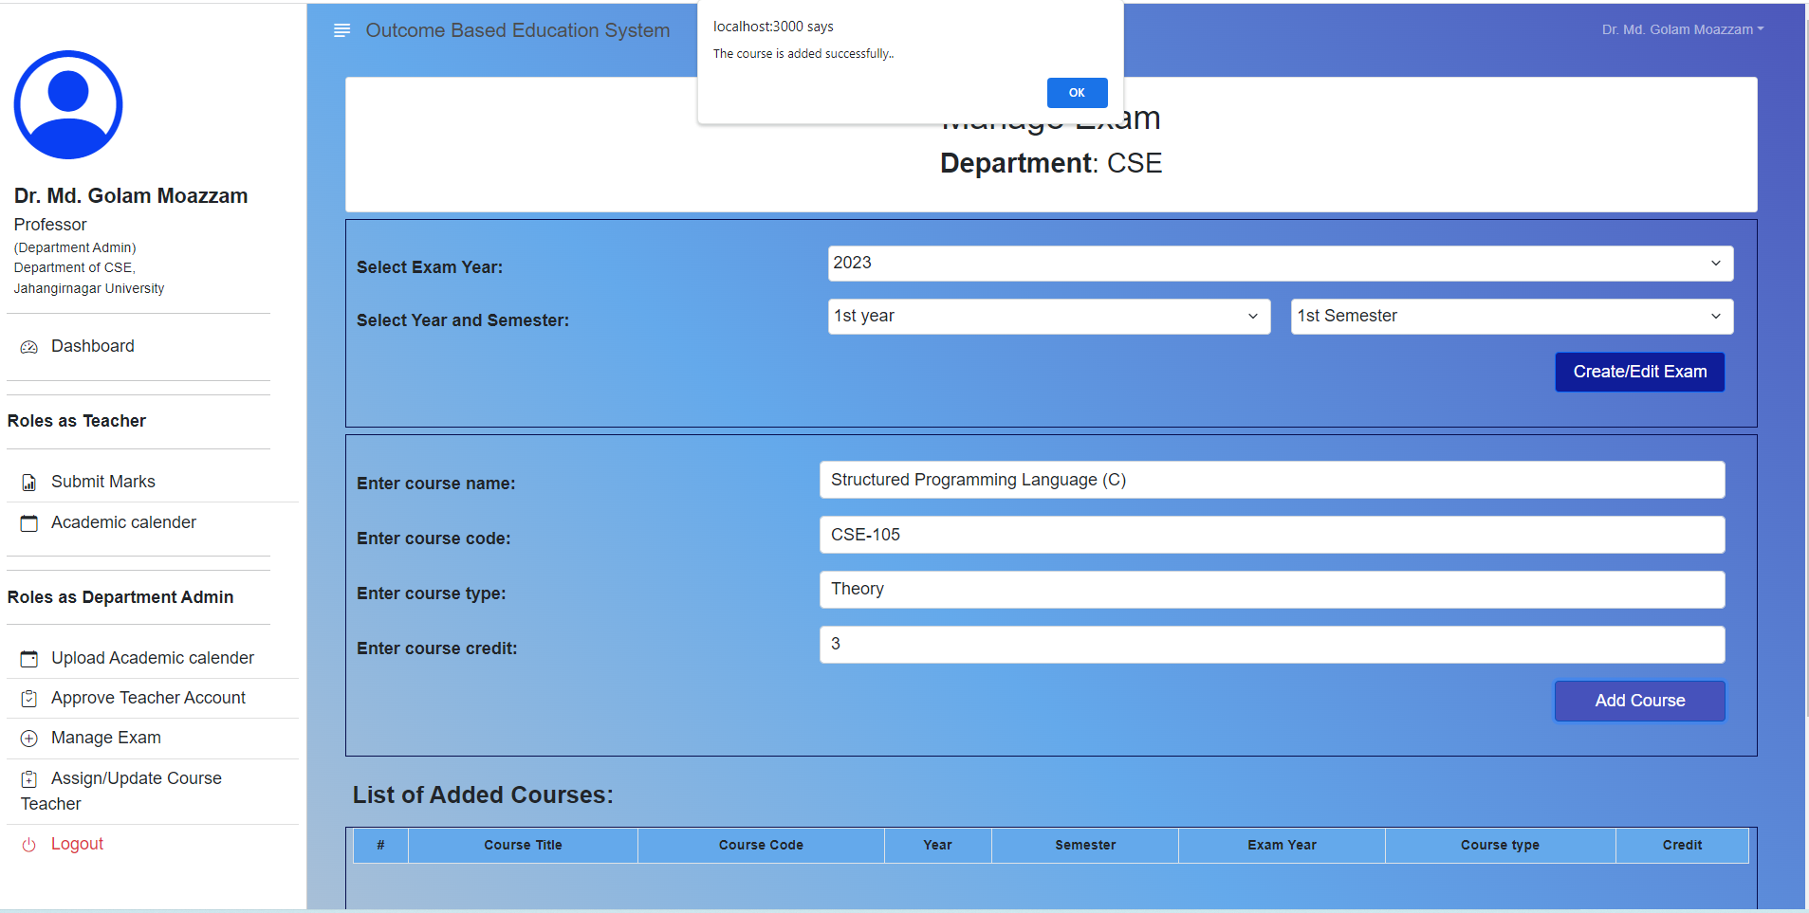
Add Course

Slide 24
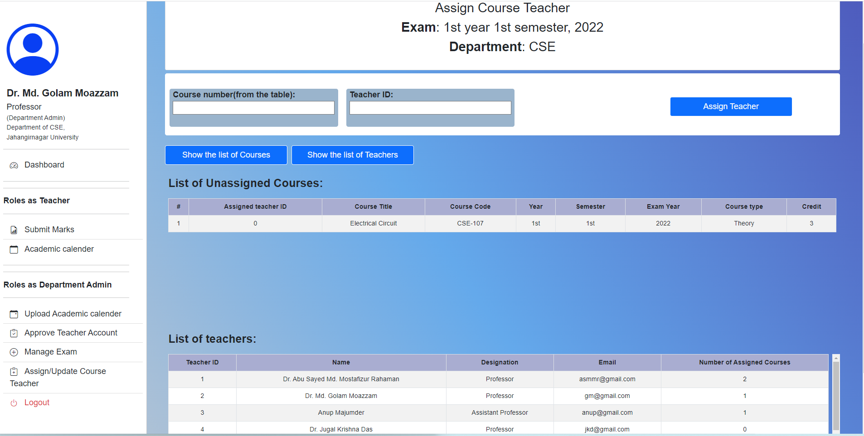
Assign Course Teacher

Slide 25
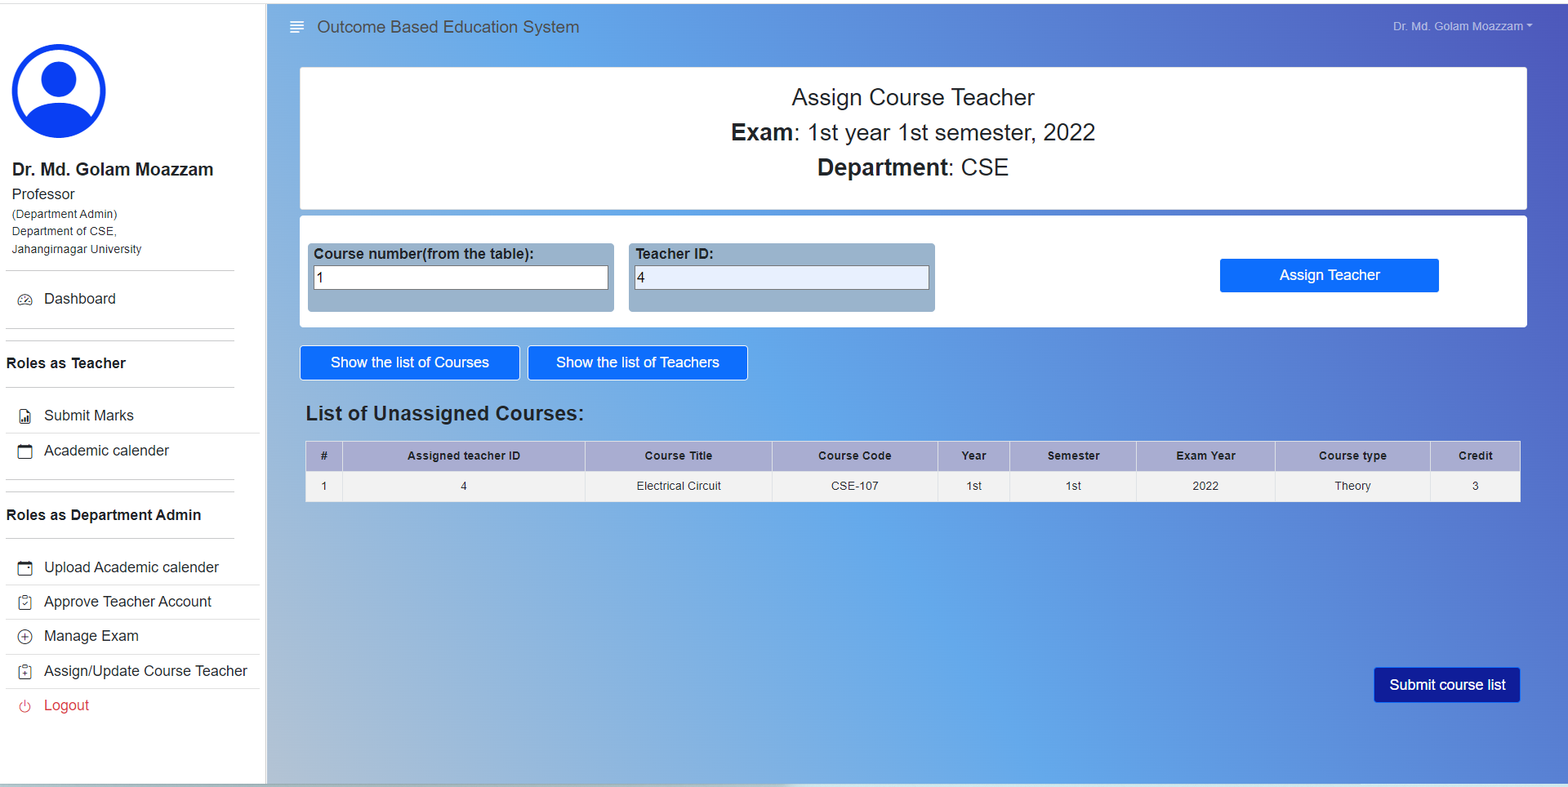
Assign Course Teacher Cont…

Slide 26
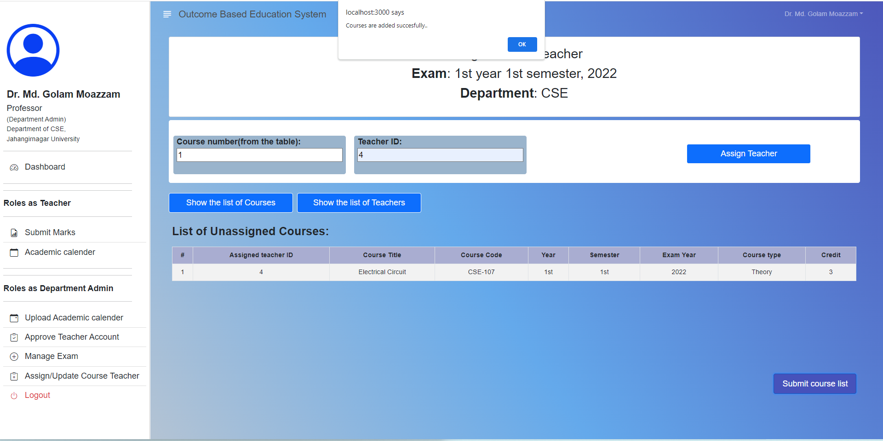
Assign Course Teacher Done

Slide 27
Exam Control Office Part

Slide 28
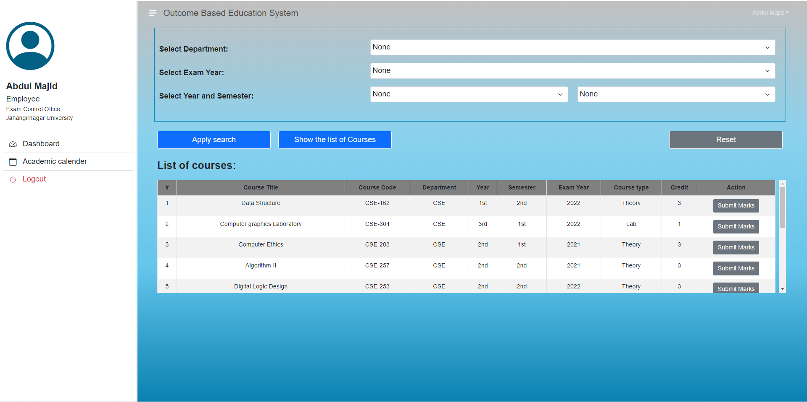
Exam Control Office Dashboard

Slide 29
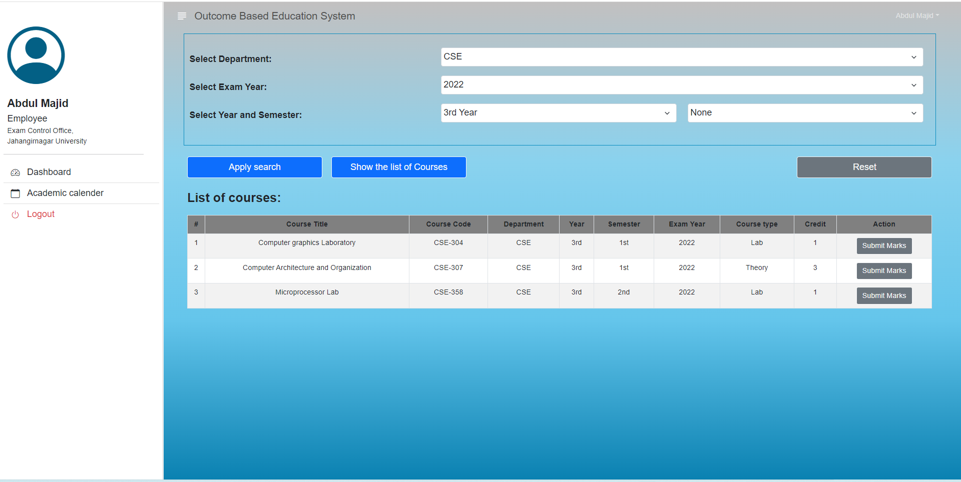
User Interface For Submit Marks

Slide 30
Thank You

